Slide 1
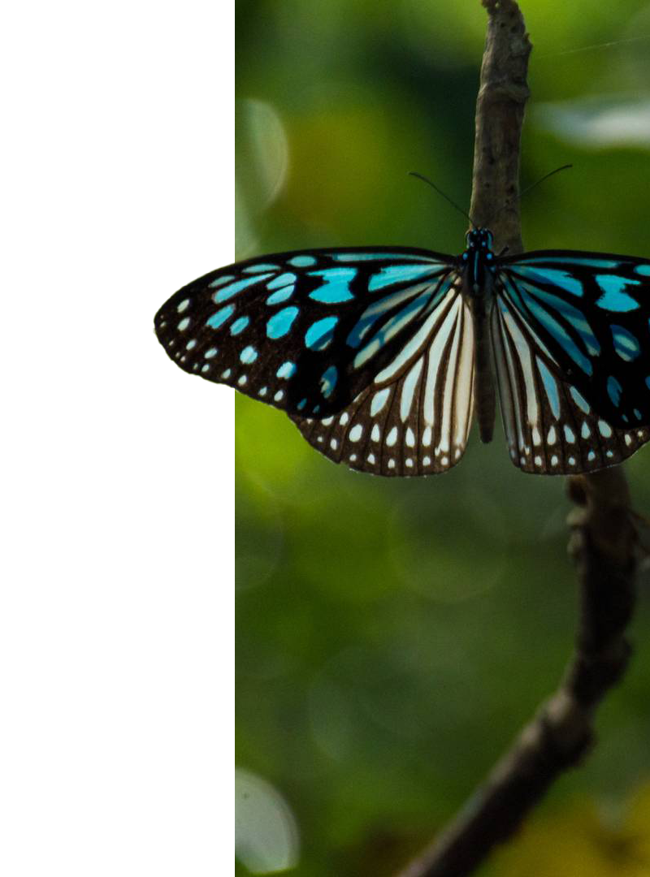
Interview for NHIC DataBase Analyst
Anannya Saha
Species Conservation Status in Canada
Notes:
Welcome to my Presentation for NHIC Database Analyst Interview. My name is Anannya Saha. Nice to meet you everyone. Today my project is about Species Conservation Status in Canada

Slide 2

About Project
Visualization of the conservation status of various species across Canadian provinces, highlighting their ecological significance and protection needs.
Notes:
In this project I used Nature Serve data which is free for public use. There was an option to export the data in excel. So After getting the data I tried to visualize the conservation status of various species across Canadian Provinces. I will also show US provinces for comparison.

Slide 3

Contents
01
02
03
04
05
Data Extraction
Data Manipulation
Data Visualization
Analysis
Next Steps
From Nature Serve website
Calculated columns to find the Conservation status in different provinces.
Displaying status based visuals on different regions
Final Outcomes of the analysis.
Risks and Action Plan
Notes:
Firstly, I will walk you through the steps I took to extract the data and the adjustments I made before visualising the contents. I will then display the calculated columns I created for the given data. After that, I'll present a few of the graphics I created with the data. Next, I'll talk about the results I achieved and the difficulties I encountered. Finally, I'll quickly go over the risks and my action plan for achieving these outcomes.

Slide 4
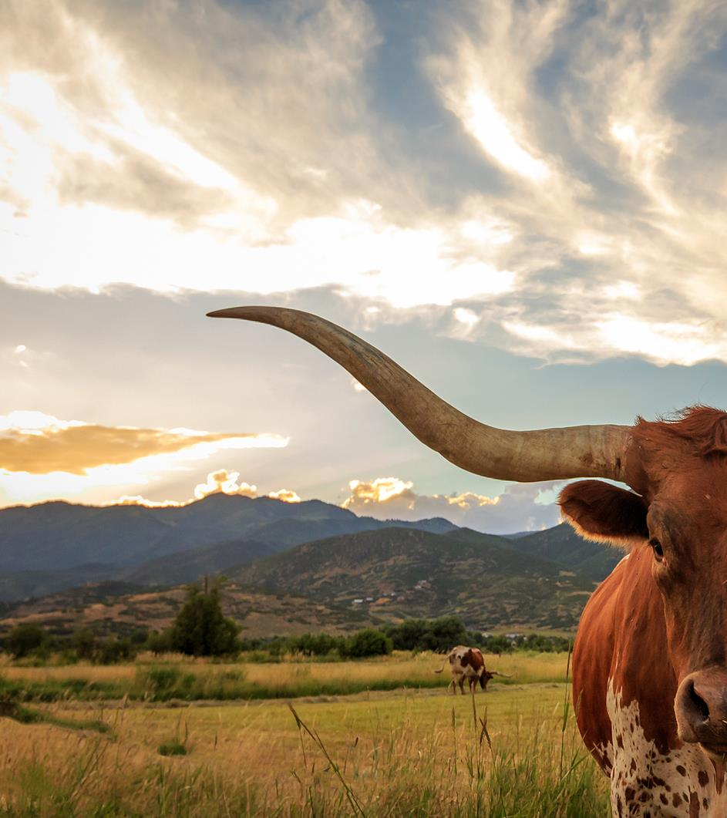
01
Data Extraction from Nature Serve

Slide 5

Common Name | Scientific Name | Element Code | Species Group (Broad) | Species Group (Fine) | NatureServe Global Rank | NatureServe Rounded Global Rank | U.S. Endangered Species Act Status | COSEWIC Status | SARA Status | Distribution | View on NatureServe Explorer
Blanchard's Cricket Frog | Acris blanchardi | AAABC01040 | Vertebrates | Amphibians | G5 | G5 |  | Endangered | Endangered/En voie de disparition | Canada (NX): ON (SX) United States (N5): AR (S5), CO (SH), IA (S3), IL (S5), IN (S4), KS (S4), KY (S5), LA (SNR), MI (S2), MN (S1), MO (S5), MS (SNR), NE (S3), NM (S3), OH (S3), OK (SNR), SD (S2), TX (S5), WI (S1), WV (SH) | https://explorer.natureserve.org/Taxon/ELEMENT_GLOBAL.2.828458/Acris_blanchardi
Eastern Cricket Frog | Acris crepitans | AAABC01030 | Vertebrates | Amphibians | G5 | G5 |  |  |  | United States (N5): AL (S5), DC (S3), DE (S5), FL (S3), GA (S5), KY (S5), LA (S5), MD (S5), MS (S5), NC (S5), NJ (S3), NY (S1), PA (S1), SC (S5), TN (S5), VA (S4), WV (S2) | https://explorer.natureserve.org/Taxon/ELEMENT_GLOBAL.2.828419/Acris_crepitans
Notes:
These are the columns I got from Nature serve. I have used only the first five and the second last column of the data. I have simple animation how I changed the data. I used the distribution column to find the status for each country and each province in the country. So I made 3 columns from this column and separated the details to put in the right column. I used python for that. The python code for this analysis is provided in the appendix. I made new rows for each status. So That I can analyse based on location.SO u can see Canada has NX status Ontario has SX status. As Ontario is in Canada that’s why country column has Canada. Same for USA. And so on and so forth.

Slide 6
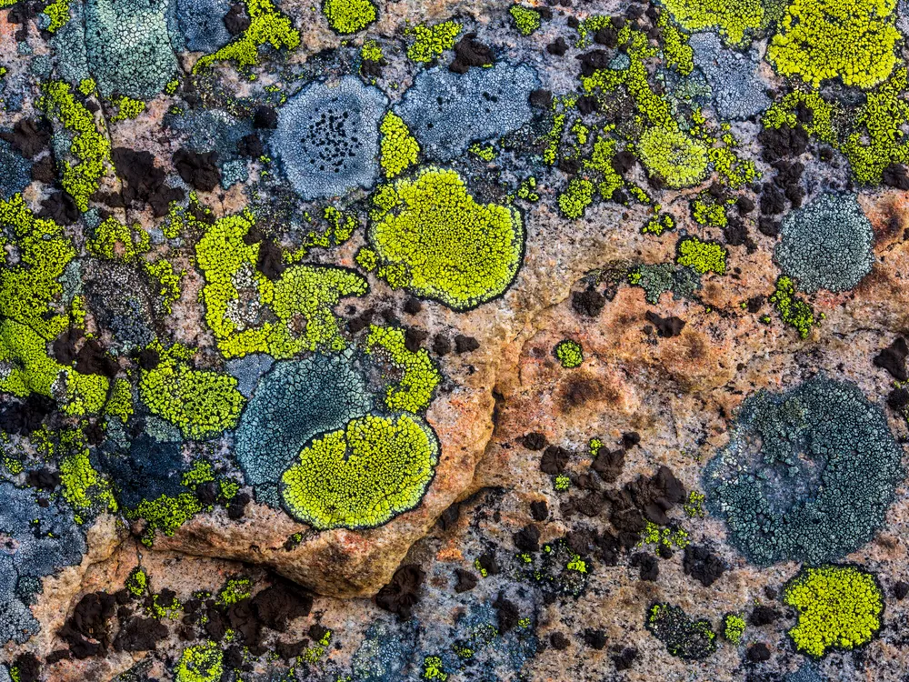
02
Data Manipulation

Slide 7
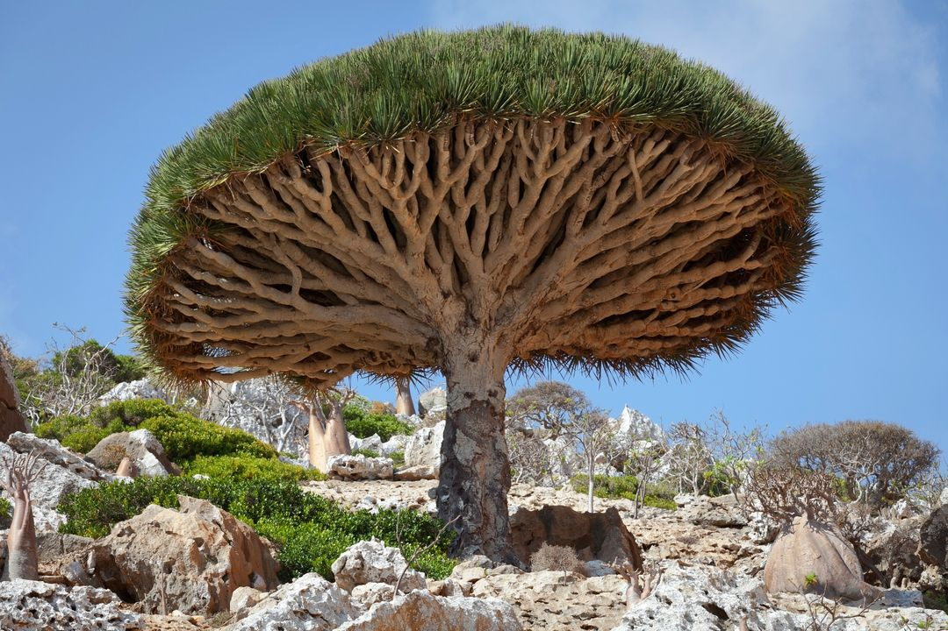
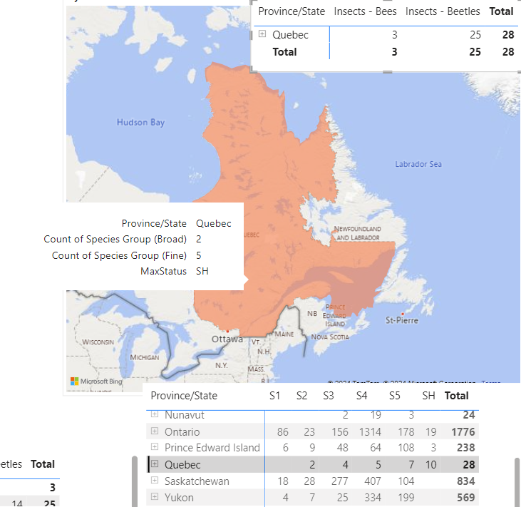
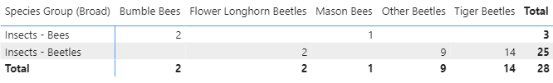
top1
Maxstatus Column Calculation
The highest number of species status in that region
Notes:
The first calculated column is MaxStatus. MaxStatus gives us the highest number of species status in that region. What does that mean? Lets look into it. So here we can see in Quebec the count of broad species is 2 and that of fine group is 5. Number of species under those group is given here too. But The max status is SH. Because most number of species belong to SH group as we can see 10 is highest.

Slide 8
top1
Maxstatus Column Calculation
The highest number of species status in that region
Notes:
The first calculated column is MaxStatus. MaxStatus gives us the highest number of species status in that region. What does that mean? Lets look into it. So here we can see in Quebec the count of broad species is 2 and that of fine group is 5. Number of species under those group is given here too. But The max status is SH. Because most number of species belong to SH group as we can see 10 is highest.

Slide 9
top1
Maxstatus Column Calculation
The highest number of species status in that region
Notes:
The first calculated column is MaxStatus. MaxStatus gives us the highest number of species status in that region. What does that mean? Lets look into it. So here we can see in Quebec the count of broad species is 2 and that of fine group is 5. Number of species under those group is given here too. But The max status is SH. Because most number of species belong to SH group as we can see 10 is highest.

Slide 10
top1
Maxstatus Column Calculation
The highest number of species status in that region
Notes:
The first calculated column is MaxStatus. MaxStatus gives us the highest number of species status in that region. What does that mean? Lets look into it. So here we can see in Quebec the count of broad species is 2 and that of fine group is 5. Number of species under those group is given here too. But The max status is SH. Because most number of species belong to SH group as we can see 10 is highest.

Slide 11
top1
Maxstatus Column Calculation
The highest number of species status in that region
Notes:
The first calculated column is MaxStatus. MaxStatus gives us the highest number of species status in that region. What does that mean? Lets look into it. So here we can see in Quebec the count of broad species is 2 and that of fine group is 5. Number of species under those group is given here too. But The max status is SH. Because most number of species belong to SH group as we can see 10 is highest.

Slide 12
top1
Maxstatus Column Calculation
The highest number of species status in that region
Significance: For Insects like Bees and Beetles maximum of their species are Possibly Extirpated in Quebec
Notes:
The first calculated column is MaxStatus. MaxStatus gives us the highest number of species status in that region. What does that mean? Lets look into it. So here we can see in Quebec the count of broad species is 2 and that of fine group is 5. Number of species under those group is given here too. But The max status is SH. Because most number of species belong to SH group as we can see 10 is highest. Significance: For Insects like Bees and Beetles maximum of their species are Possibly Extirpated in Quebec

Slide 13
Status Color
Extinct | Possibly Extinct | Critically Imperilled | Imperiled | Vulnerable | Apparently Secure | Secure
GX | GH | G1 | G2 | G3 | G4 | G5
NX | NH | N1 | N2 | N3 | N4 | N5
SX | SH | S1 | S2 | S3 | S4 | S5
Notes:
This is another calculated column to define the color of the max status. If the maxstatus is SX then it means Extinct and will give red color to the region of the map.

Slide 14
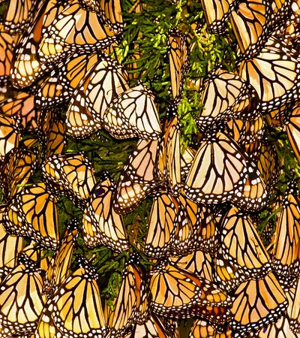
03
Data Visualization

Slide 15
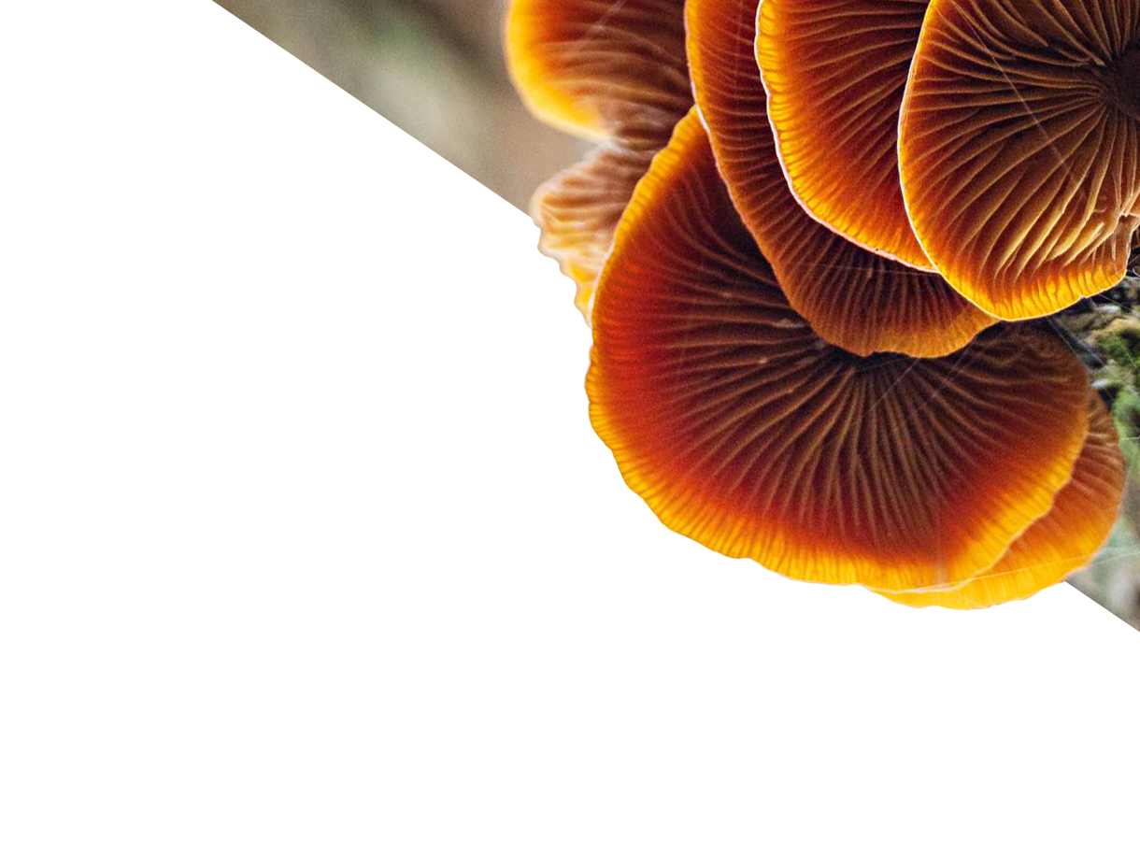
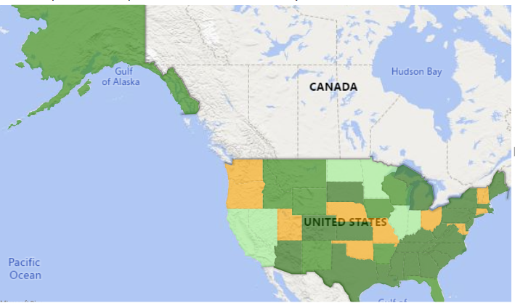
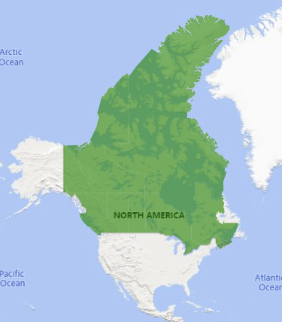
Data Visualization
Overall Species status of regions
Notes:
When you look at the status from a bird’s eye view you can see Canada is all green which means among all the species under different statuses, S4 is the largest group for all the provinces. But USA has a few yellow provinces which means their largest group of species belongs to vulnerable. Lets dig deep now. Shall we?

Slide 16
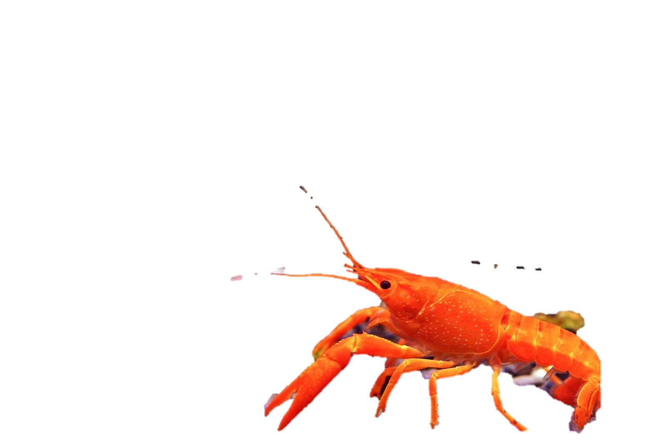
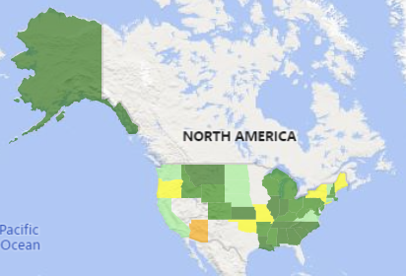
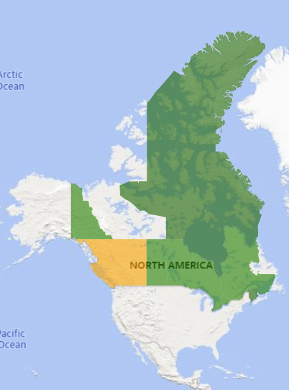
Data Visualization
Overall Species status of regions
Notes:
Maximum Shrimps and cray fish in British Columbia and alberta is Critically imperilled. where as other regions are secure or possibly secure. If you see no color then no species of shrimps and cray fish has been recorded in that region.

Slide 17
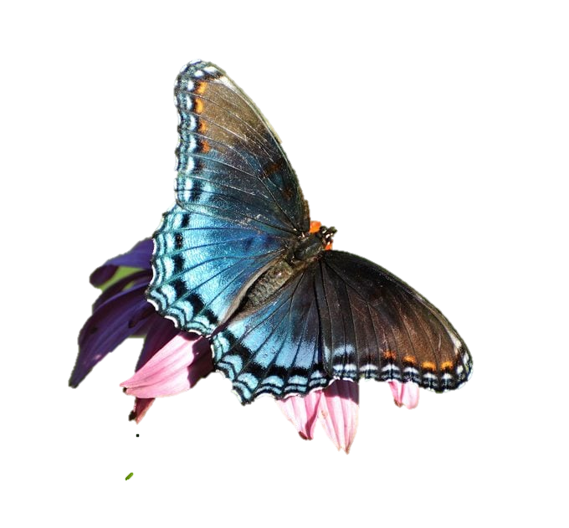
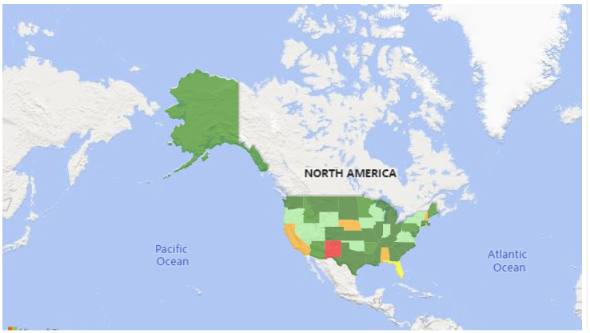
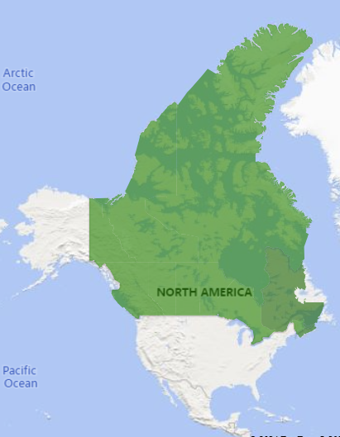
Data Visualization
Overall Species status of regions
Notes:
Most Insects species in Canada are possibly secure which is great. Lets dig deep into it too.

Slide 18
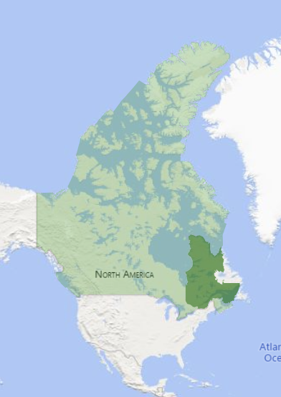
Data Visualization
Overall Species status of regions
Notes:
We already saw that most species of bees and beetles from Quebec are possibly extirpated. But if you filter butterfly and moths. Quebec is green as grass.

Slide 19
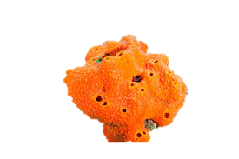
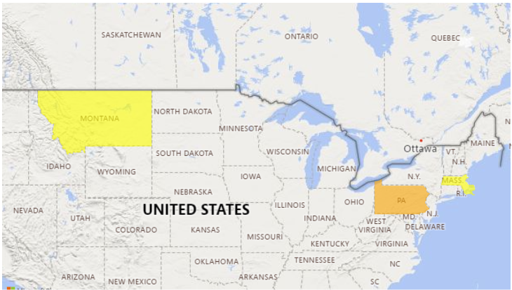
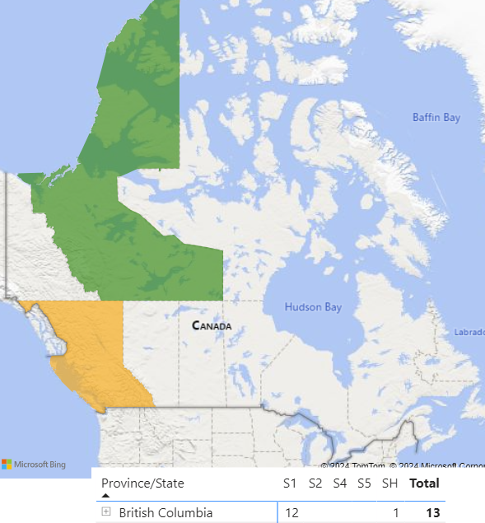
Data Visualization
Overall Species status of regions
Notes:
For marine Invertebrates British Columbia is not doing good which we also saw in case of cray fish and shrimp.

Slide 20
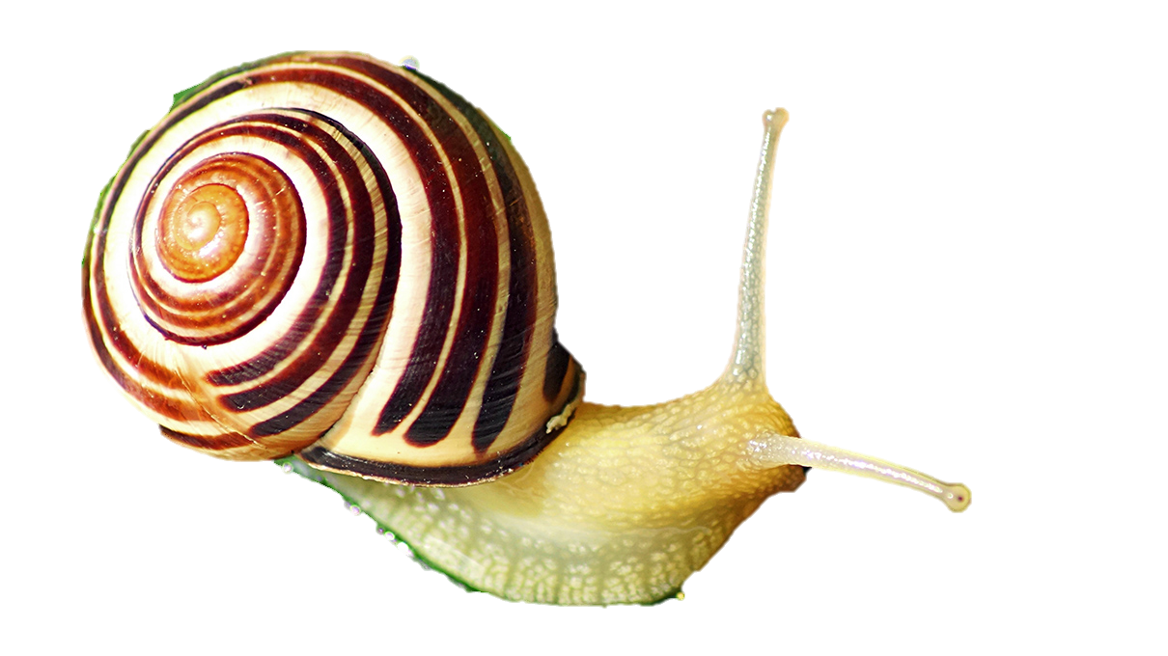
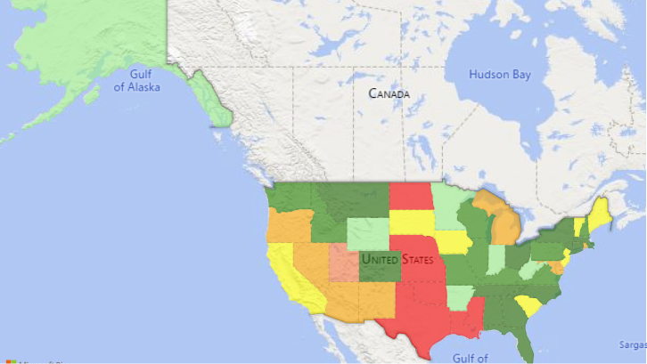
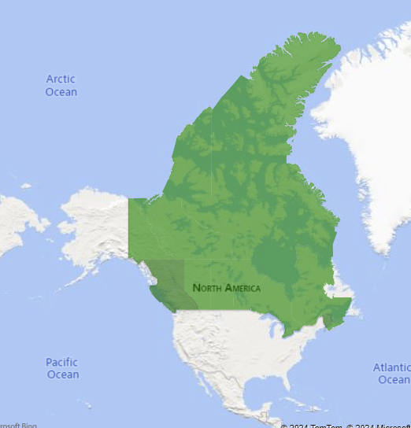
Data Visualization
Overall Species status of regions
Notes:
But interestingly for mussels, snails and other molluscs British Columbia is secure. I am guessing they might be producing it for consuming.

Slide 21
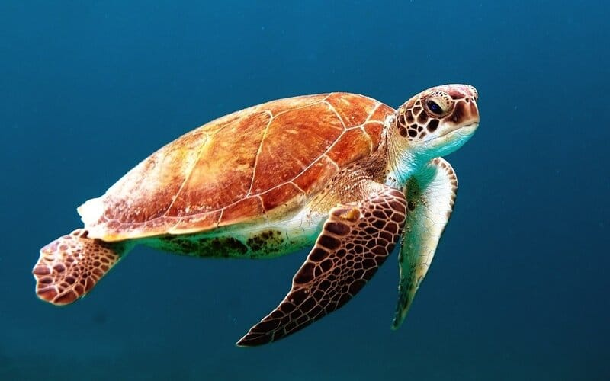
04
Outcomes and Highlights

Slide 22
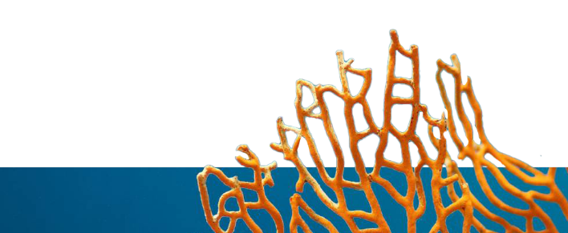
Highlights
Provincial Highlights
Ontario has the highest number of Apparently Secure Species
British Columbia has the highest number of Secure Species
Alberta has the highest number of Vulnerable Species
Status Highlights
Vascular plants has the highest number of species who are Secure.
Insects – Butterfly has the highest number of Apparently Secure species
Marine Invertebrates has the least number of species and most of them are extinct

Slide 23
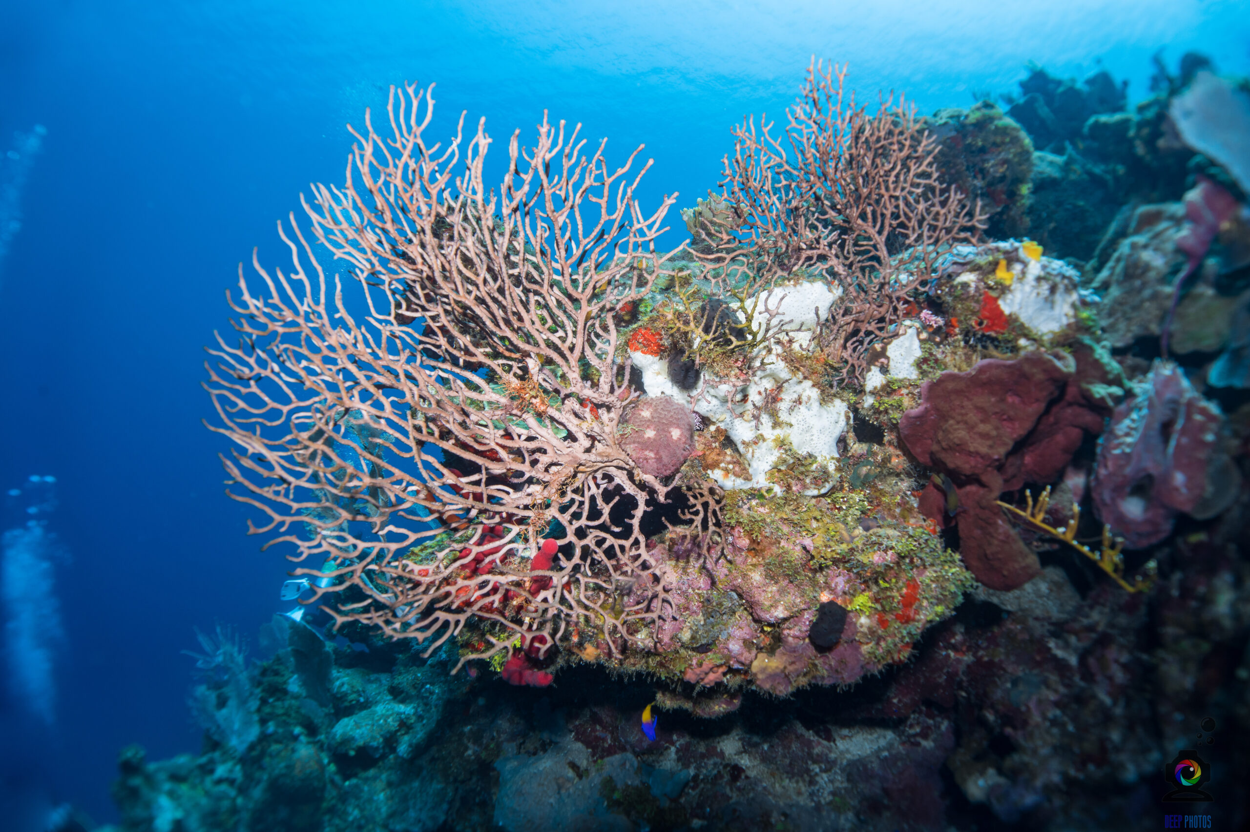
Outcomes
Maximum species in Canada are Apparently Secure
Shrimp, Cray fish group in British Columbia is Critically imperiled
Most marine invertebrates in British Columbia is critically imperiled
Most Species of Insects like Bees and beetles are possibly Extinct in Quebec

Slide 24
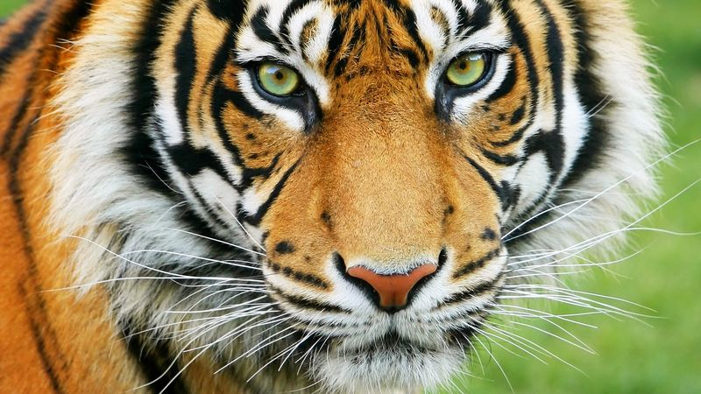
05
Risks and Action Plan

Slide 25
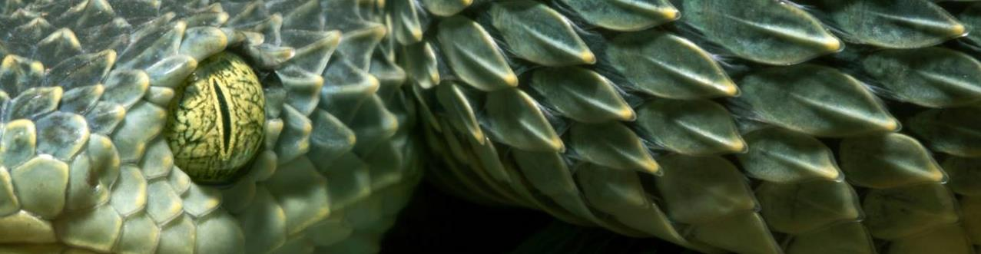
Risks
Habitat Loss and Fragmentation: Due to reduction of population of species there are possible habitat loss and extinction of species, which will affect the ecosystem and the biodiversity
Climate Change: A species' population changes have an impact on the environment and may ultimately have an impact on the climate. Conversely, the vulnerable population of species may be impacted by climate change in terms of their everyday activities.
Overexploitation: Hunting vulnerable population and harvesting endangered plants can lead to extinction.
Notes:
Habitat Loss and Fragmentation: "Picture our ecosystem as a grand, interconnected web. Each species plays a crucial role, like strands in this web. When populations decline, key strands are broken, leading to habitat loss and potential extinction. This weakens the entire web, disrupting the balance and reducing biodiversity, making the ecosystem more vulnerable."
Climate Change: "A species' population changes have a ripple effect, influencing the entire environment. These changes can alter local ecosystems and even impact global climate patterns. Conversely, the daily functions of vulnerable species are severely impacted by climate change, threatening their survival."
Overexploitation: "Imagine a finely tuned balance scale, where nature and human activity must remain in equilibrium. Overhunting vulnerable species and harvesting endangered plants can tip this balance, pushing species toward extinction. This not only reduces biodiversity but also destabilizes ecosystems that depend on these species for their health and resilience."

Slide 26
5 year Action Plan
 | Year 1 | Year 2 | Year 3 | Year 4 | Year 5
Step name | Conduct Detailed Baseline Assessments | Implement Habitat Protection and Restoration Initiatives | Strengthen Legislation and Enforcement | Promote Sustainable Practices and Community Involvement | Monitoring, Evaluation, and Adaptive Management
Elaboration | Develop a Comprehensive Conservation Strategy | Climate Change Mitigation Efforts | Public Awareness and Education Campaigns | Incentive Programs for Conservation | Report and Communicate Progress
Notes:
"Our journey begins with a thorough understanding of the current state of our ecosystems. In the first year, we'll conduct detailed baseline assessments to gather critical data. This data will inform the development of a comprehensive conservation strategy, setting a solid foundation for our efforts.“ "In year two, we transition from planning to action. We'll protect and restore critical habitats to combat habitat loss and fragmentation. Additionally, we'll implement climate change mitigation efforts to safeguard vulnerable species, ensuring their resilience against changing environmental conditions.“ "In the third year, we'll focus on strengthening legislation and enforcement to prevent overexploitation and illegal activities. Simultaneously, we'll launch public awareness and education campaigns to engage and empower communities, fostering a culture of conservation.“ "Year four emphasizes sustainability and community involvement. We'll promote sustainable practices and create incentive programs to encourage active participation from individuals and organizations. This collective effort will help ensure long-term conservation success.“ "In the final year, we'll focus on monitoring and evaluating our efforts. Adaptive management will allow us to adjust strategies based on what's working and what isn't. We'll also transparently report and communicate our progress, ensuring accountability and continuous improvement."

Slide 27
Appendix
The Python code for creating the dataset.
The Visuals I created for this presentation. PowerBI Dashboard.
Data that I produced from the Python Code.
Another dashboard I created for another project.

